Slide 1
Looking for bat evidence in the church interior
Start the slideshow to begin the interactive presentation
Next >>

Slide 2
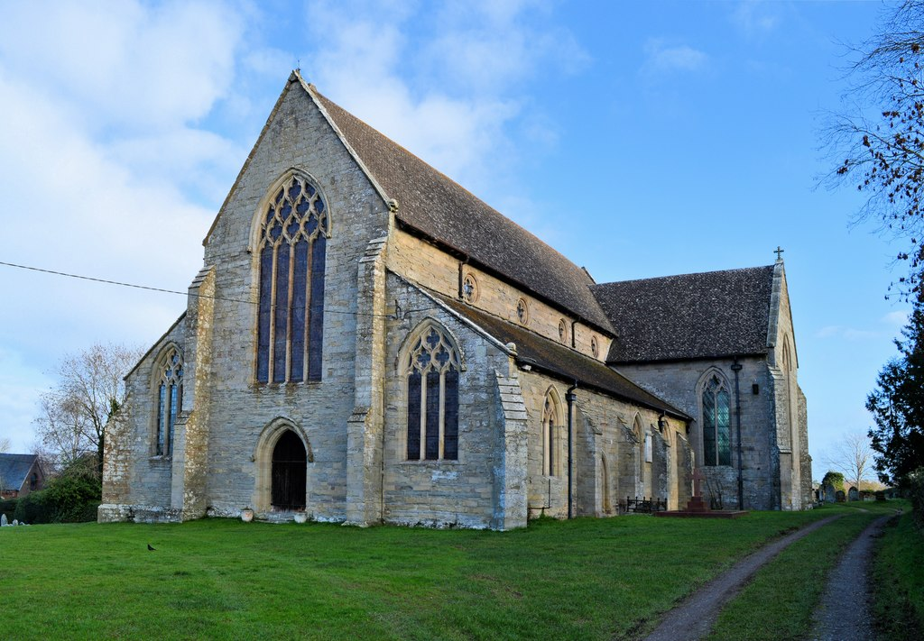
Bring with you – click a number on the checklist
1
Survey form and a pen/pencil
2
Torch & binoculars (optional)
3
A survey buddy if you can (or let someone know where you’re going and when to expect you home)
Next >>
Photo credit: The Bats in Churches Team

Slide 3
What you need to know – click a number on the checklist
1
These are one-off surveys to look for bat evidence
2
Take place June-August
3
There are two surveys. The survey you’re carrying out depends on the church you’ve selected.
Click on the survey titles below to learn more
NATIONAL BATS IN CHURCHES STUDY
CHURCH BAT DETECTIVES
Next >>

Slide 4
National Bats in Churches Study click on the icons to learn more about the survey
The survey involves:
1.Daytime survey to look for evidence of bats.
2.Questionnaire with your church contact
3.Collect droppings for DNA analysis
4.Leave a bat detector in the church for 2 nights
This is our priority survey. We aim to identify the bat species, if there are bats using the church. To do this we ask that you borrow equipment from us to collect bat droppings and to record any bat calls.
The 1000 churches in this survey were randomly selected. The sample is stratified to ensure it reflects the age structure of English churches and to ensure we have a large enough sample in each region.
1000
<<Back
Not sure if your church falls under this survey? Login to the survey portal batsinchurches.bats.org.uk and go to My Churches. You’ll see a list of your selected churches and the survey they fall under.

Slide 5
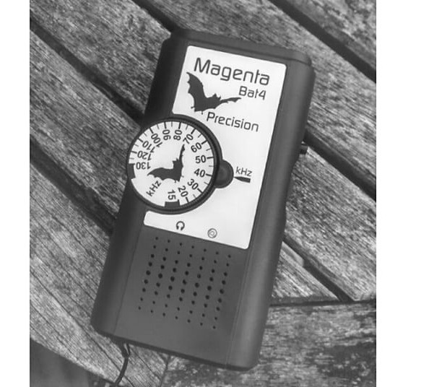
Church Bat Detectives click on the icons to learn more about the survey
<<Back
The survey involves:
1.Daytime survey to look for evidence of bats.
2.Questionnaire with your church contact
You do not need to book equipment
In this survey we want to understand whether there is evidence of bats using the church.
We do not aim to identify the bats
This survey can be carried out in any Church of England or Churches Conservation Trust church that isn’t part of National Bats in Churches Study-that’s a lot of churches!
16,000+
Optional extra if you have your own bat detector
Confident with bat surveys and have your own equipment? Any additional work to identify species can be saved on our online system. It isn’t necessary but a fantastic bonus if you can!
Not sure if your church falls under this survey? Login to the survey portal batsinchurches.bats.org.uk and go to My Churches. You’ll see a list of your selected churches and the survey they fall under.

Slide 6
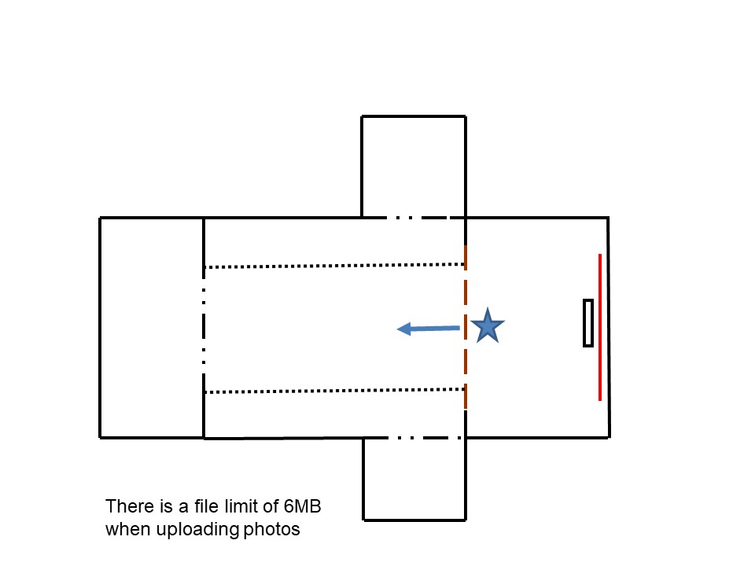
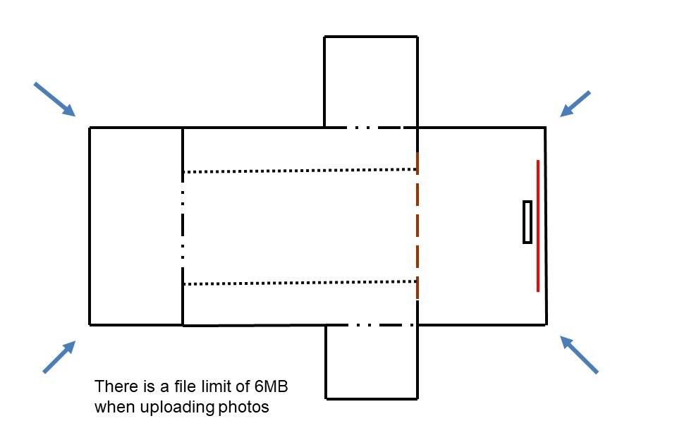
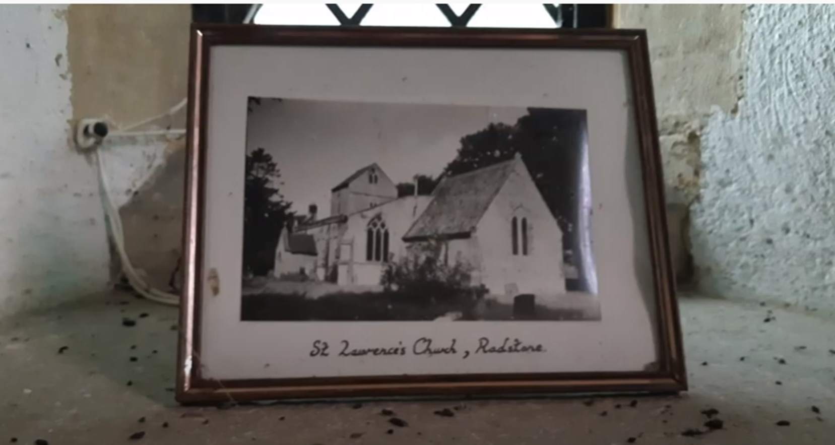
Elements of the daytime bat evidence survey – click a number on the checklist
1
Outside the church. Take photos of the 4 corners of the church.
Stand in chancel and take photos towards the nave.
Inside the church. Take two photos standing in the chancel and looking towards the nave; one of the body of the church and one of the ceiling.
2
3
Look for evidence of bats within the church
Next >>
Photo credit: The Bats in Churches Project

Slide 7
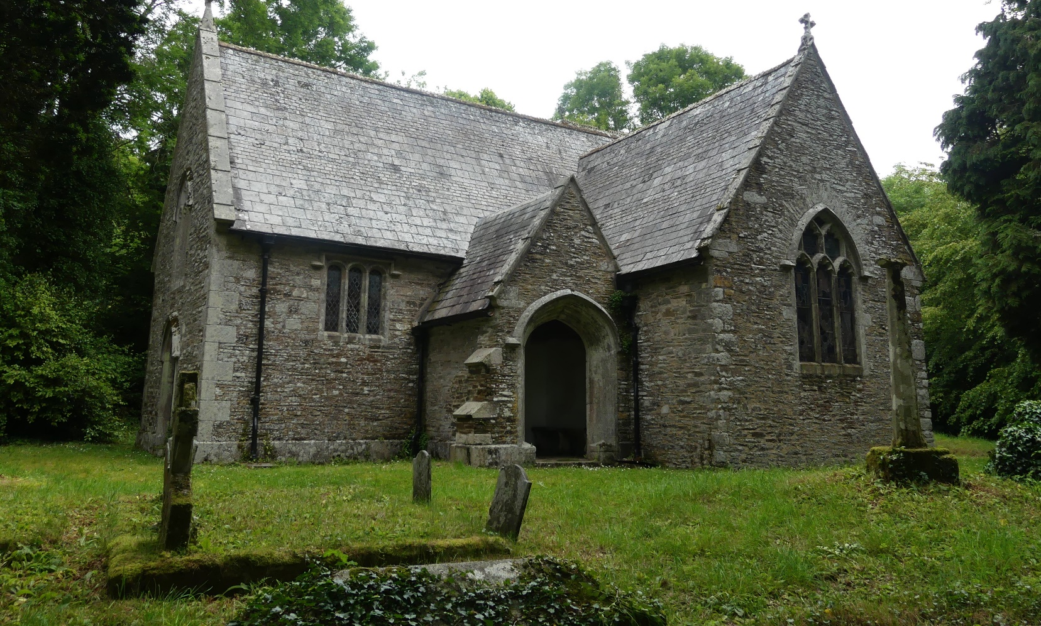
Where to look for bat evidence? – click on the number below
NB Maternity roosts are usually on the warmer south and south east sides of the church
1
Check church porch for droppings and urine stains
Next >>
Photo credit: The Bats in Churches Team

Slide 8
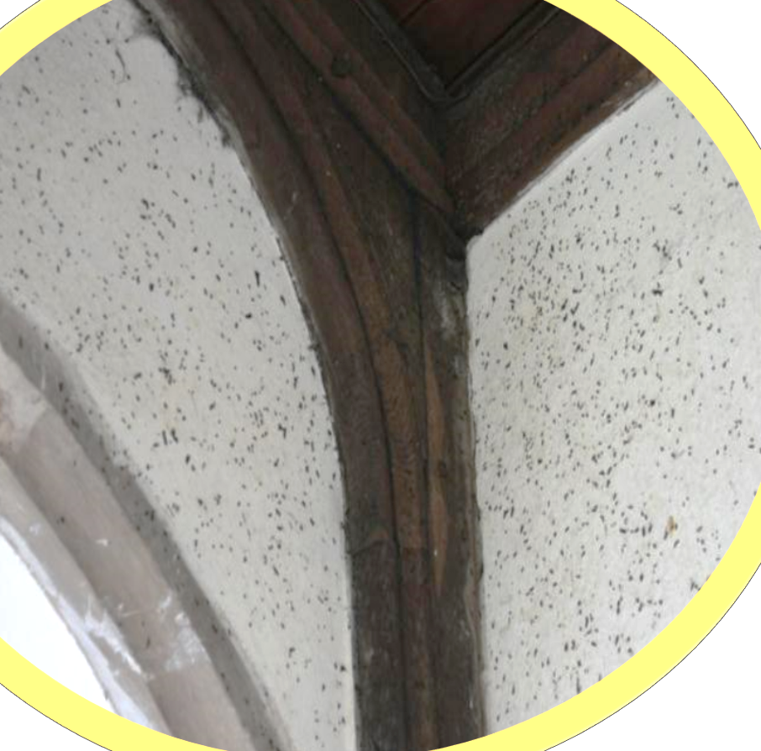
Search the church interior – click on the number below
2
Systematically work round the interior to check for droppings:
Walls
Floors
Pews
Window sills
Top of cupboards (and other low ledges)
NB behind the altar can be hard to clean!
Next >>
Photo credit: Philip Parker

Slide 9
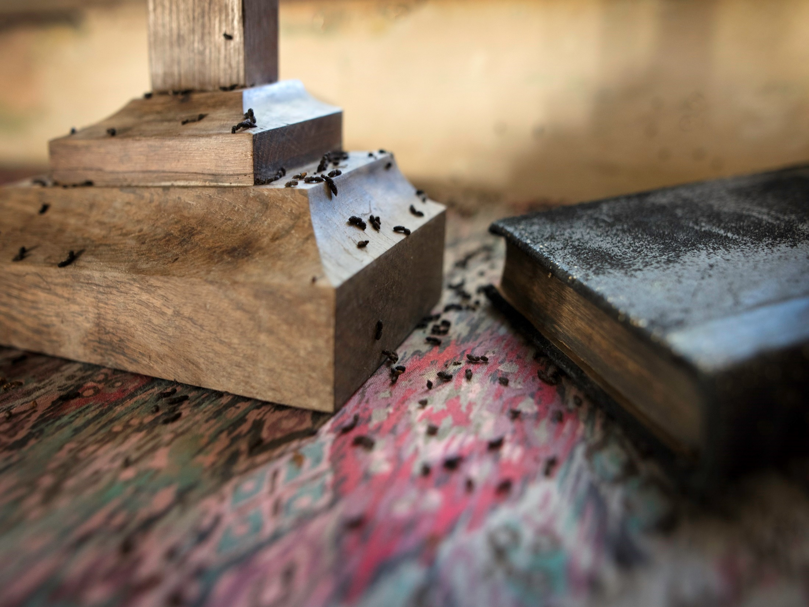
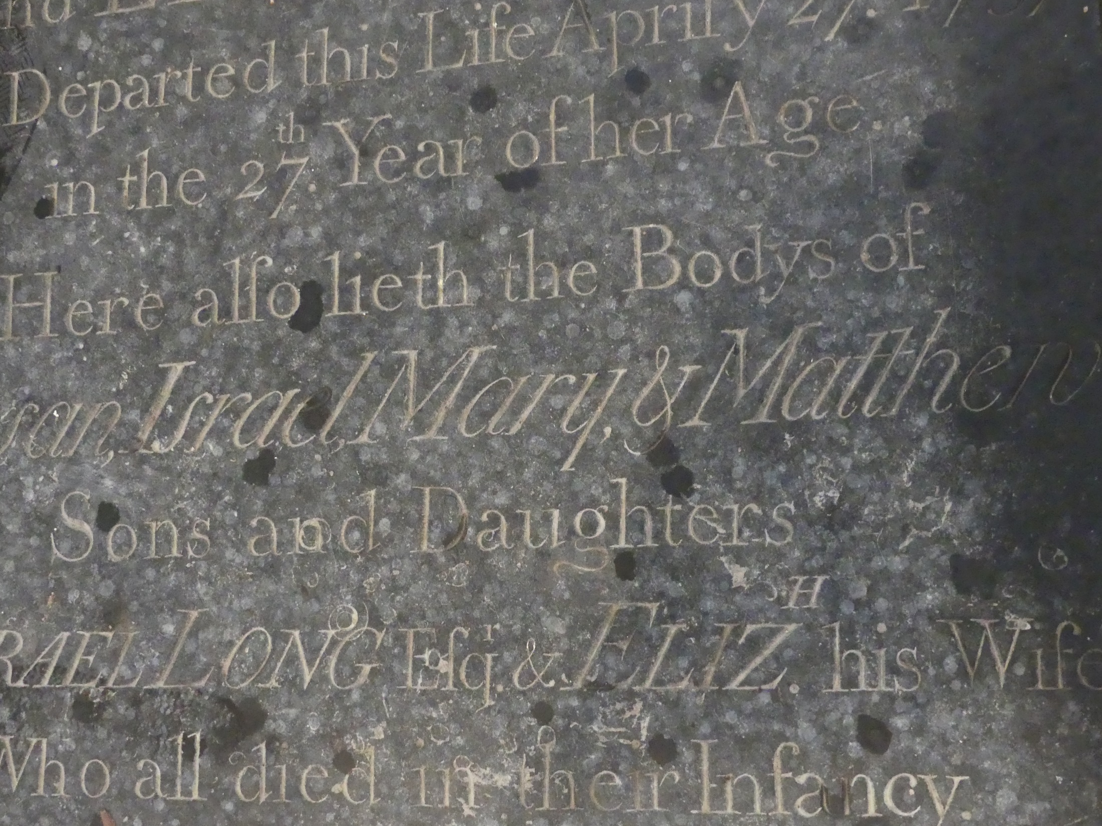
Search around furnishings – click on the number below
Check church furniture for droppings/urine stains
Altar
Memorials
Brasses
Pews
Check behind:
Radiators
Hangings
Pictures
3
Next >>
Photo credit: The Bats in Churches Project

Slide 10
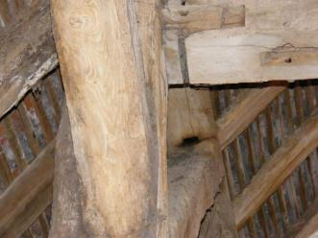
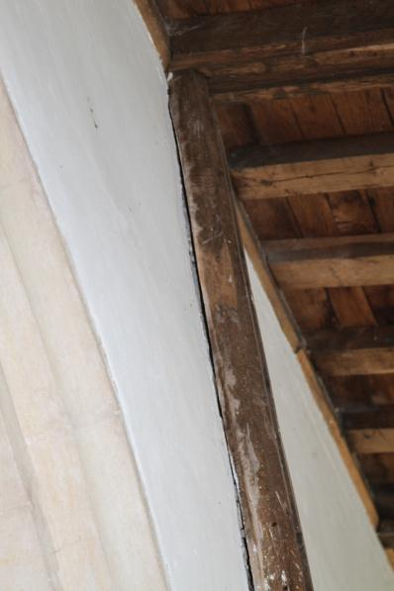
Looking for bats – click on the number below
4
Use torch & binoculars to scan for bats or evidence
Ceiling
Joints in timbers
Crevices
5
Look for droppings against the posts.
Gaps between vertical posts and the wall are favoured roosting locations for individuals or small numbers of bats.
Next >>
Photo credit: Sylvia and Roger Jiggins

Slide 11
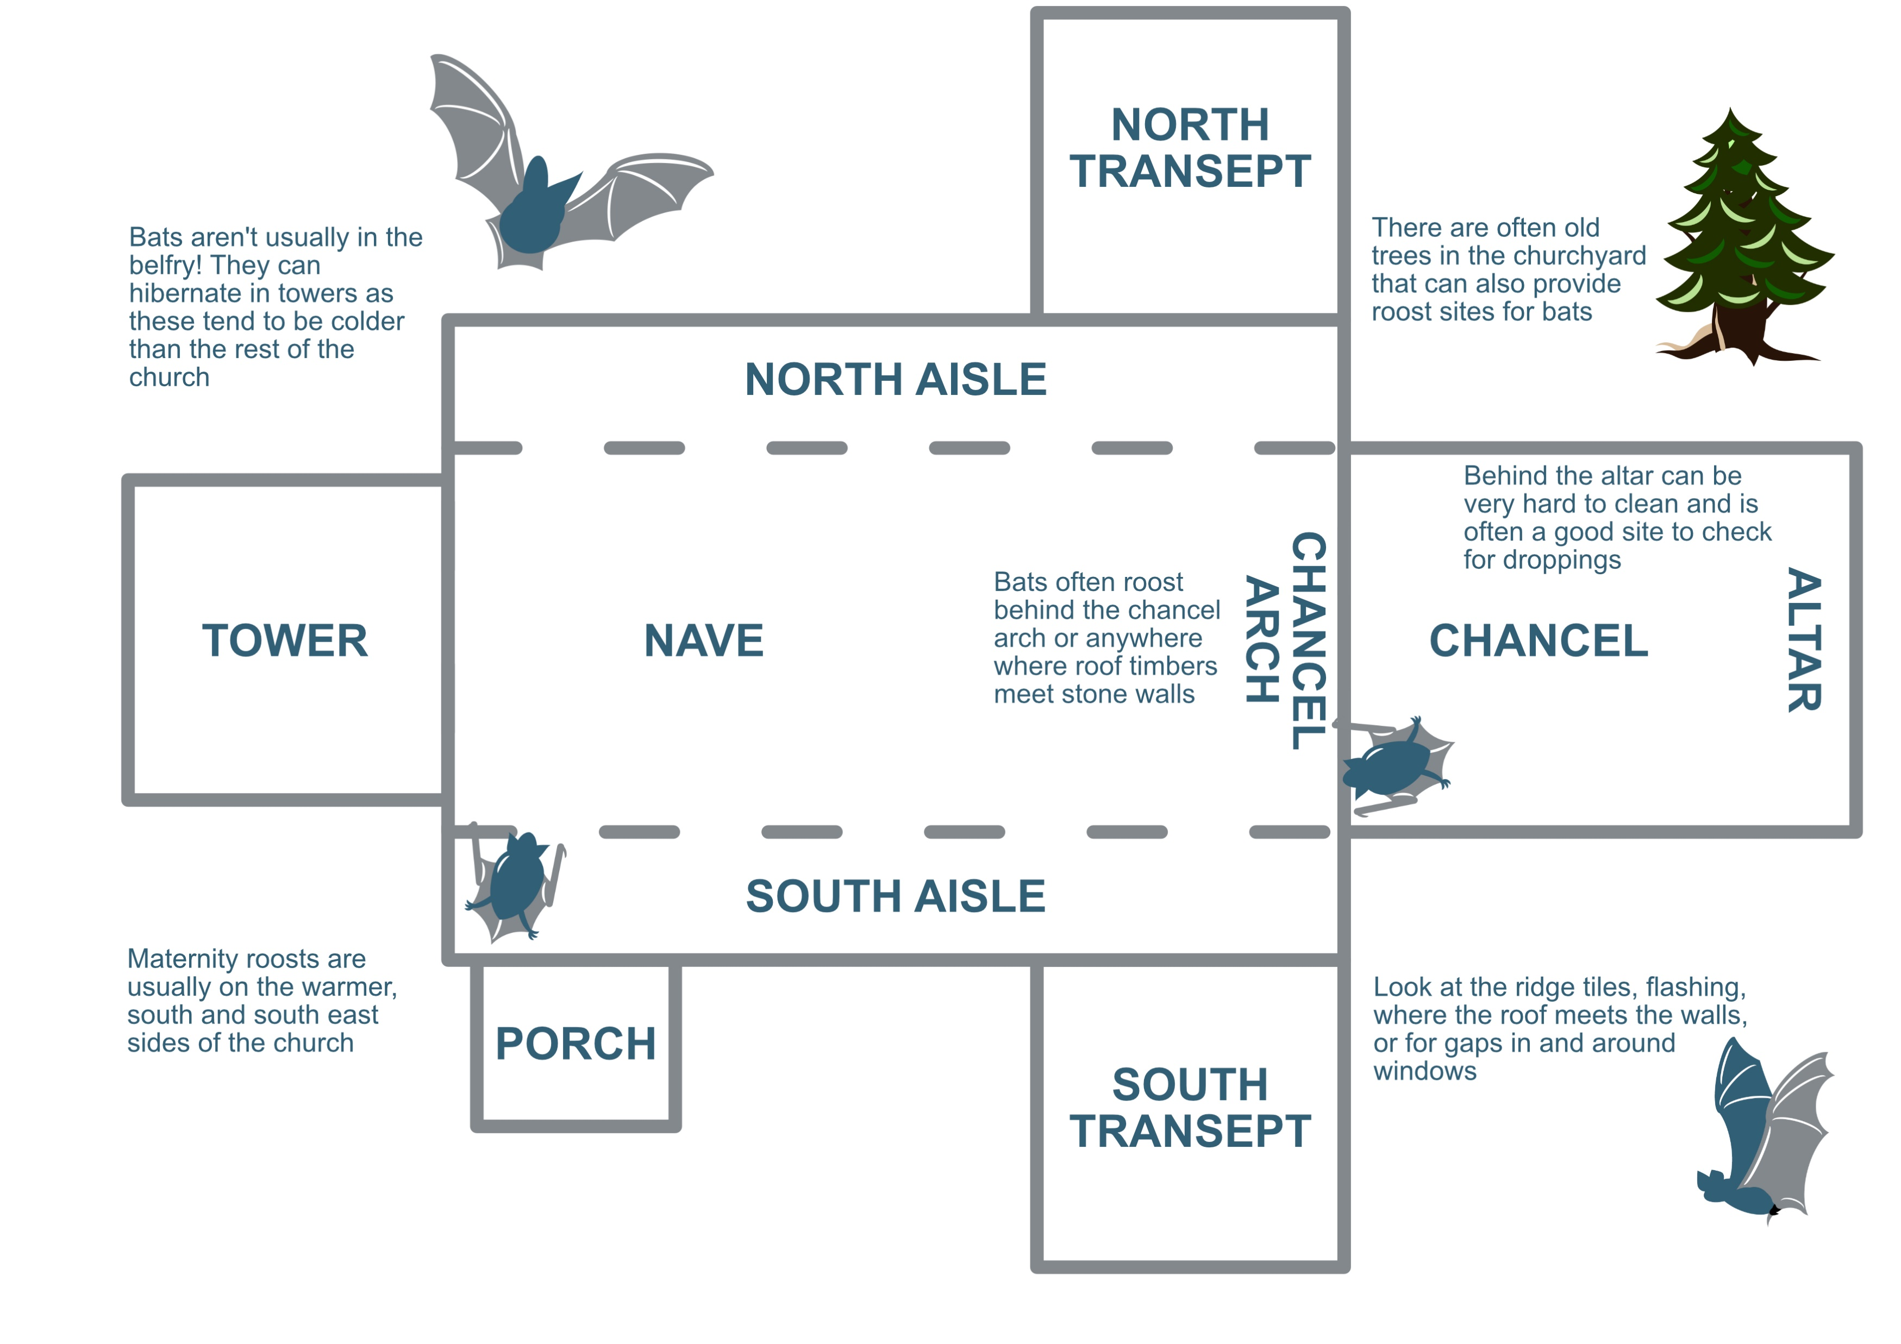
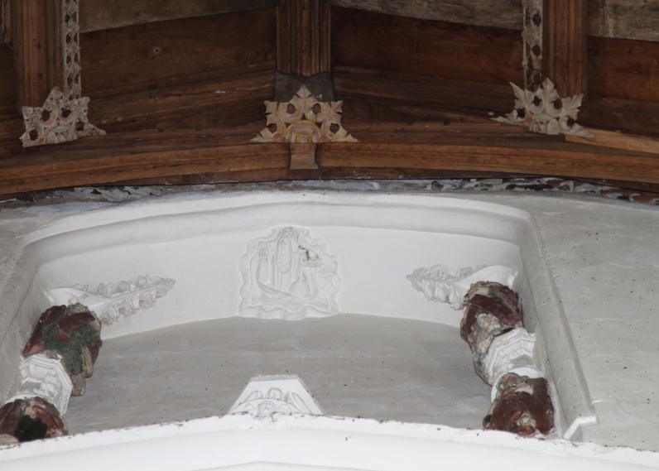
Chancel arch – click on the number below
6
Gaps between the chancel arch and nave/chancel roof (where the roof timbers have pulled away from the wall) are one of the typical roosting locations for pipistrelles, brown long-eared bats and Natterer’s bats.
Next >>
Photo credit: Philip Parker

Slide 12
Looking for bats – click a number on the checklist
If it is easy to look inside of the tower please do so, but you don’t need to go into locked areas of the church.
Please do not:
Go into the belfry
Climb ladders
Go into voids
7
Next >>

Slide 13
When you find evidence
On the survey form you’re asked:
1. WHERE in the church you found the evidence (i.e. chancel, nave)
2. WHAT evidence did you find (i.e. droppings or urine)
3. HOW MANY (if it’s droppings we ask you to tell us roughly how many. There are three categories, see image below)
4. Take a photo of the evidence
DNA column for National Bats in Churches Study only. Please indicate if you’ve collected a sample.
Next >>

Slide 14
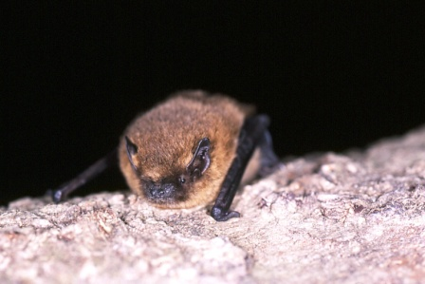
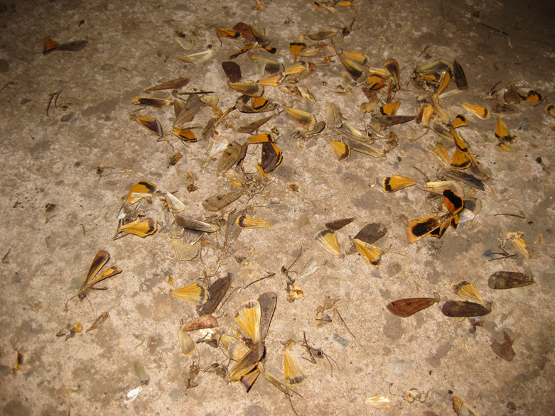
What kind of evidence may you find?
Click on an image to see how to recognise each of these clues
DROPPINGS
URINE
Next >>
BATS
FEEDING REMAINS

Slide 15
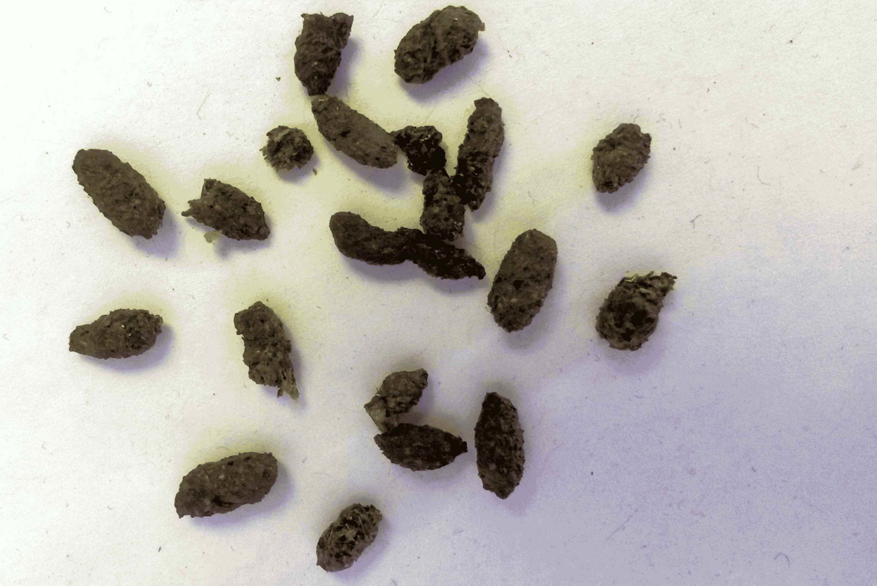
Bat Droppings
Crumble Test
Unsure whether it is bat or mouse droppings? Use a pair of gloves or tissue and rub it between your fingers. Bat droppings will crumble easily, as they’re made up of insect exoskeletons.
Accumulations of bat droppings can be found underneath roosts or their points of access in and out of the church.
You might see scattered droppings where bats have been flying around the building.
Bat droppings look like mouse droppings. They’re around 6-15mm in length, but each bat species has slightly different looking droppings. Don’t worry, we’re not asking you to identify the bats from the shape of their droppings!
<<Back to menu

Slide 16
Bat Urine
You may find these small urine splashes (in this image the whitish marks are the dry urine and the darker are fresh wet splashes).
You may see urine staining around wood, below roosting locations.
Not sure if it’s bat urine? It can sometimes be hard to differentiate urine and other issues, like water damage. If there’s urine there’s likely to be droppings too, so look thoroughly for droppings. You can always send us a photo as well if you’re not sure.
<<Back to menu
Photo credit: The Bats in Churches Project

Slide 17
Live or dead bats
If you come across a roosting bat, please leave it alone and don’t shine your torch at it.
If you see a bat flying in the day or on the floor it may need help. If this happens seek help from The National Bat Helpline. Importantly, if you need to pick up a bat to rescue it, you must wear gloves.
Hopefully, you will not find a dead bat, but if you do and it is physically intact, you can support the Animal and Plant Health Agency (APHA) surveillance for rabies, a disease found in a small number of bats in the UK. To find out more, or request a dead bat pack, see the Bat Conservation Trust website www.bats.org.uk/advice/found-a-dead-bat/testing-dead-bats
The National Bat Helpline
0345 1300 228
Opening hours between May-September for emergency bat care calls:
Mon-Fri 9:30-16:30 & 18:00-22:00
Sat-Sun 10:00-22:00
You can find information online at www.bats.org.uk/advice/help-ive-found-a-bat
<<Back to menu
Photo credit: Common pipistrelle by Hugh Clark / www.bats.org.uk

Slide 18
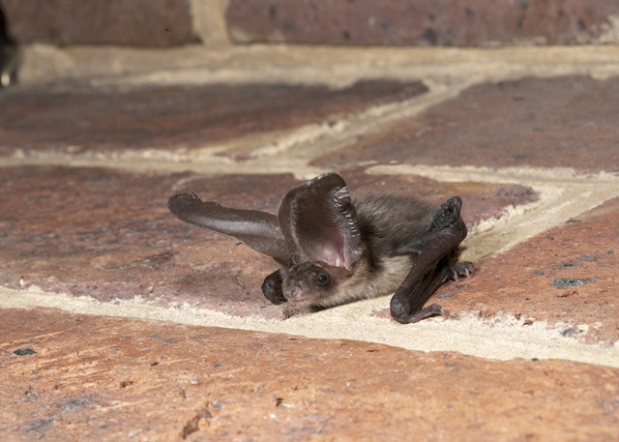
Feeding remains
We aren’t specifically looking for feeding remains in this survey but accumulations of moth and butterfly wings can indicate the presence of bats.
Some bat species eat large prey such as moths and take them to a regular feeding perch. They’ll eat the abdomen and discard the unpalatable wings.
If you see this, it is likely that you’ll also find evidence of bat droppings and urine.
Yellow underwing moth (Noctua spp.).) wings underneath a brown long-eared bat feeding perch.
<<Back to menu
Photo credit: Brown long-eared bat by Hugh Clark / www.bats.org.uk

Slide 19
Can you see any bat evidence in this photo?
YES
NO
Bat droppings were found under the curtains.
Next >>
Photo credit: Philip Parker

Slide 20
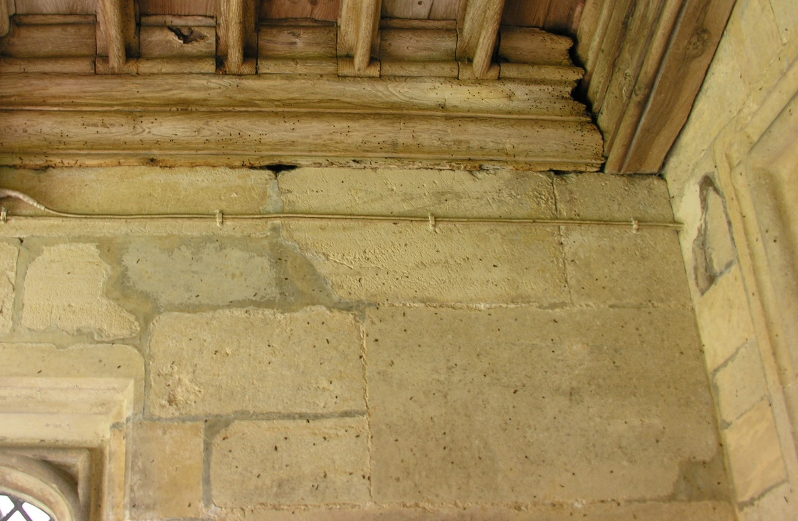
Can you see any bat evidence in this photo?
YES
NO
Bat droppings can be seen clinging to the wall under this Daubenton’s bat roost in the porch.
Next >>
Photo credit: Shirley Thompson

Slide 21
Can you see any bat evidence in this photo?
YES
NO
The mess here is from the candle wax.
Next >>
Photo credit:

Slide 22
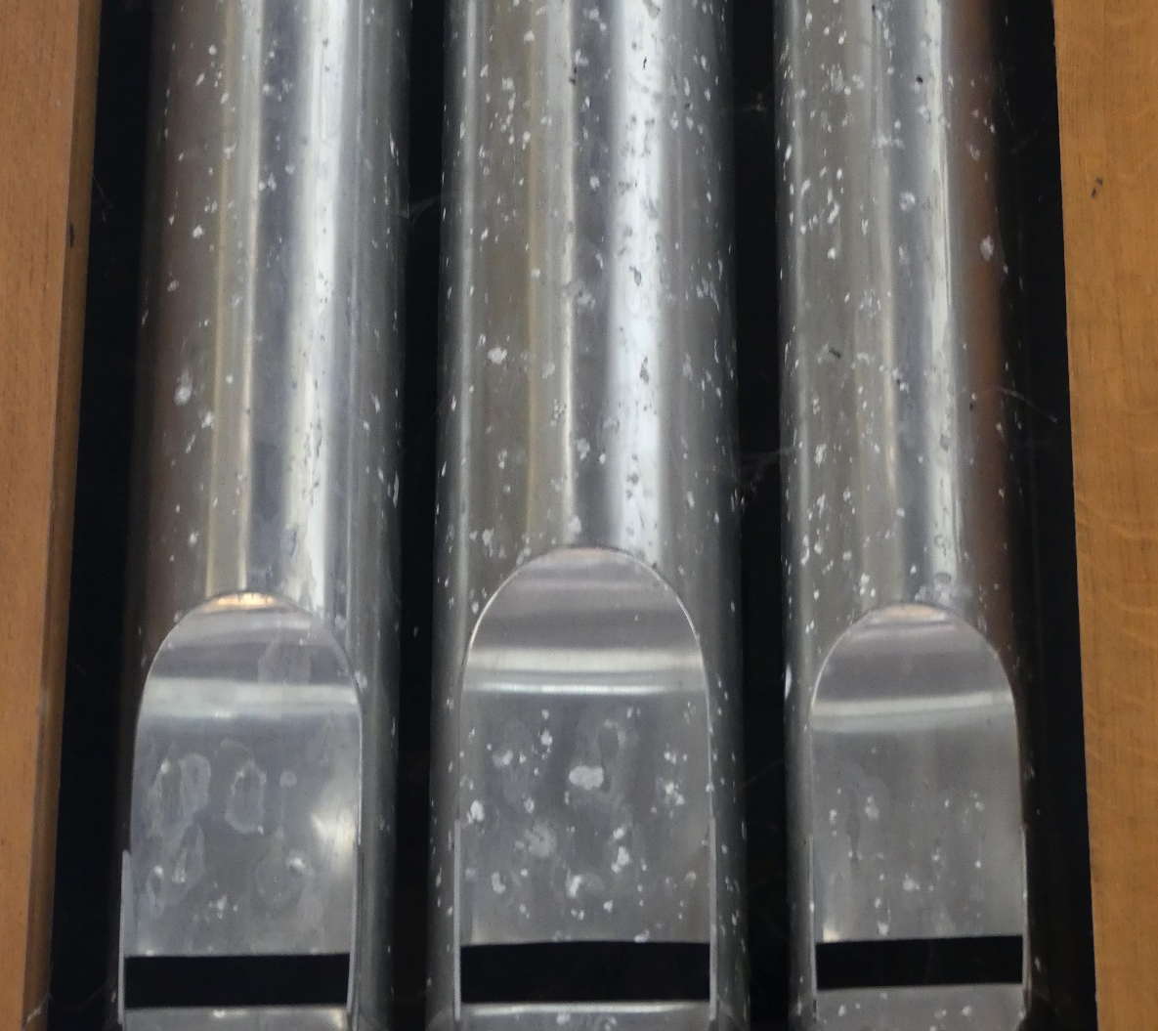
Can you see any bat evidence in this photo?
YES
NO
You can see urine marks/splashes on the organ pipes.
Next >>
Photo credit:

Slide 23
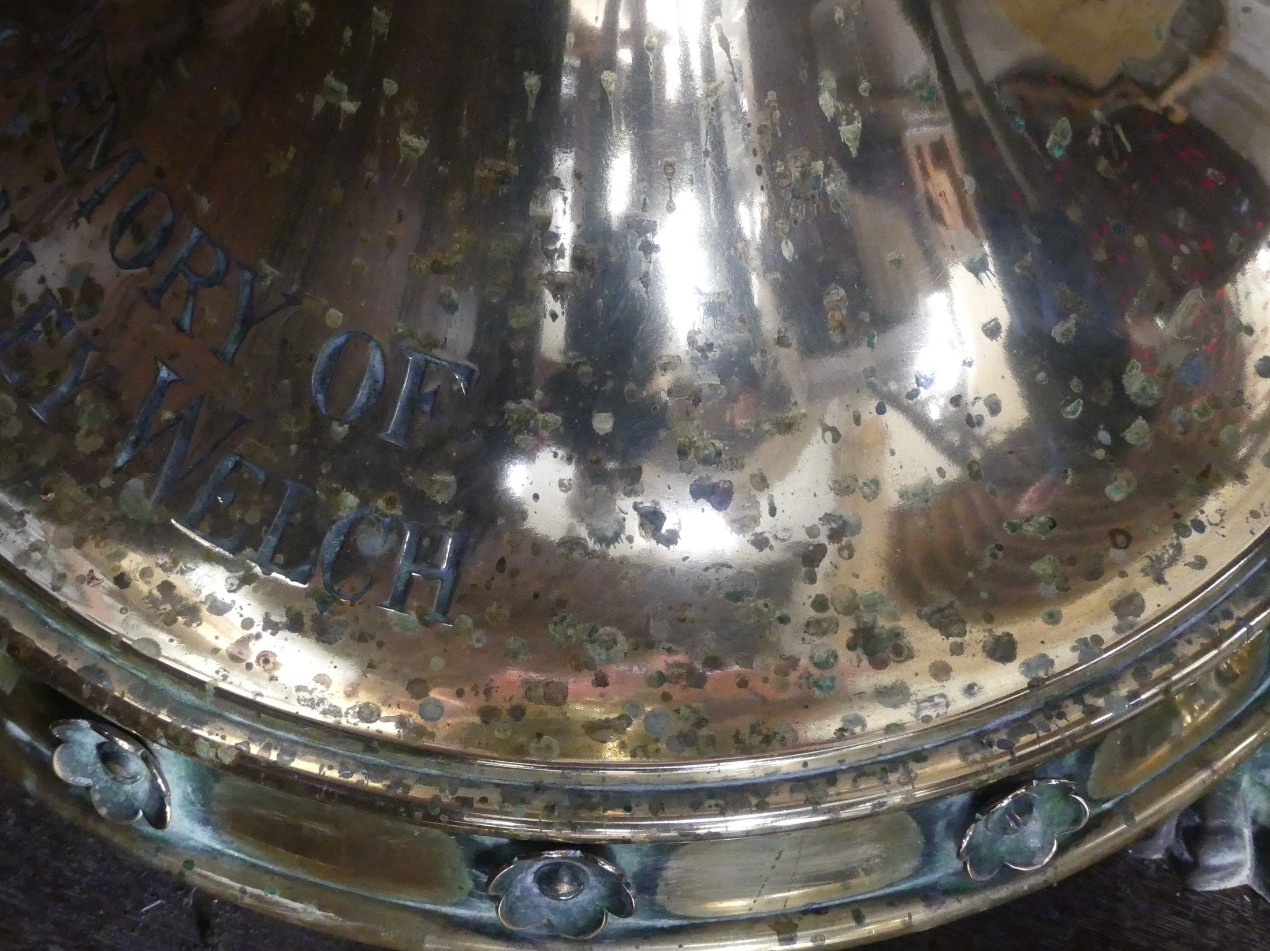
Can you see any bat evidence in this photo?
YES
NO
Bat urine is slightly acidic so it can cause damage to the brass. You can see these small urine splashes.
Next >>
Photo credit:

Slide 24
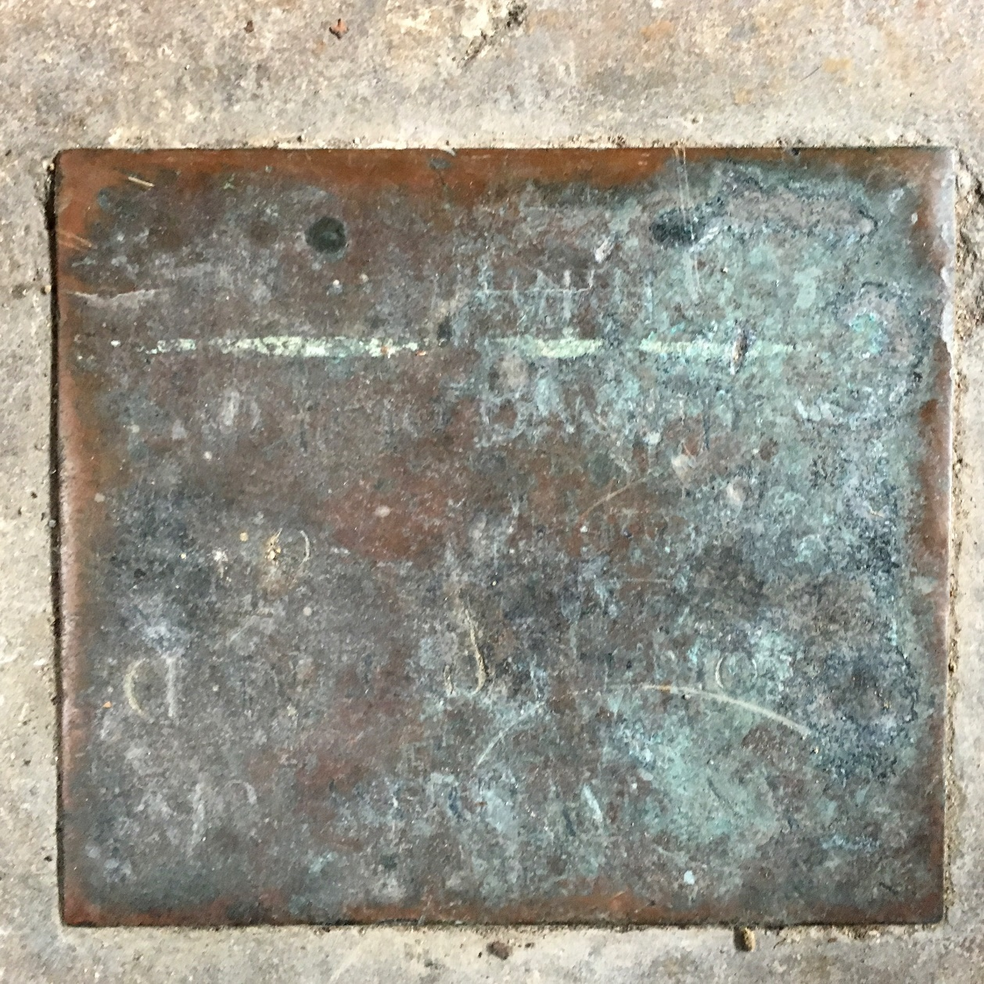
Can you see any bat evidence in this photo?
YES
NO
It’s not just bat urine that can cause damage. This damage to the brass was caused by a non-breathable covering.
Next >>
Photo credit:

Slide 25
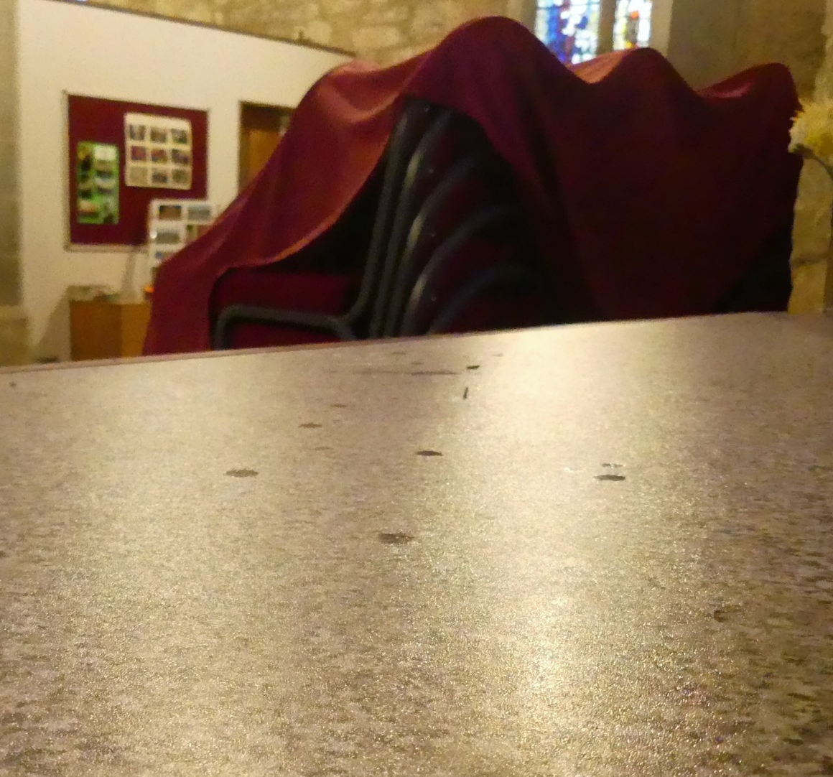
Can you see any bat evidence in this photo?
YES
NO
There are a few circular splashes of bat urine on the table if you look closely.
Next >>
Photo credit:

Slide 26
Check your learning with our quiz!
You’re asked to take 6 photographs (4 outside and 2 inside),plus a photo of any bat evidence you find-Click on your answer
TRUE
FALSE
Next >>

Slide 27
I need to survey my selected church for multiple years-Click on your answer
TRUE
FALSE
No, these surveys are one-off surveys. However, if you’d like to monitor the roost on an ongoing basis it would great to take part in the NBMP Roost Count.
Next >>

Slide 28
Droppings that crumble easily are bat droppings and not mouse droppings-Click on your answer
TRUE
FALSE
The crumble test is a great way of telling whether they’re bat droppings. Please use a tissue or gloves and wash your hands afterwards
Next >>

Slide 29
We hope you’re more confident looking for bat evidence, but if not… click a number on the checklist
1
You could try contacting your local bat group. You may find an experienced bat surveyor who would be interested in joining you or they may be able to provide support. www.bats.org.uk/support-bats/bat-groups
Bring a survey buddy. Two people looking for bat evidence is better than one.
2
You may not find bat evidence and this is okay! Not all churches will have bats roosting in the interior. We do not assume that after a one-off evidence survey that bats definitively do not use the church. We can only confirm the positive, where bat evidence has been recorded. If you don’t find bat evidence it is still an important record. Please fill in the online survey form to record your visit!
3
If after doing the crumble test you’re still not sure they’re bat droppings, note it down, take a photo and send it in. If you’re doing the National Bats in Churches Study collect it in one of the vials provided.
4

Slide 30
Good luck with your survey!
The full instructions are on your resources page
batsinchurches.bats.org.uk

